Slide 1

SEHH2240 Group Project
Group A07
204A A07 Chen Wei Yui 24015277A ​
204A A07 Ting Ho Man 24176301A​
204A A07 Shum YU Ching 24168915A​
204C A07 Lu Chun Hei 24191330A​
204A A07 Lin Rui Peng 24168294A

Slide 2

Introduction

Slide 3

B2C Platform
CC-store management system :
An management system for an e-commerce platform for HKCC students
The whole system is designed to provide manger to mange and maintain the HKCC online shop
For enterprise
All data in the online shop can be shown
For maintainer
Not only viewing data but also editing data in online shop

Slide 4
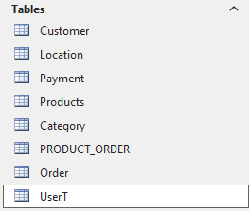
CC-store Table
Location: save data about where customers can receive products
Customer: store the information of users who register on our website
Payment: save the payment methods available for customers to choose
Order: store information about the orders selected by customers
Product: contain all the information about the products offered by the platform
Category: classify various products
UserT: store the username and password of our Login system
Use table to store the online shop data

Slide 5
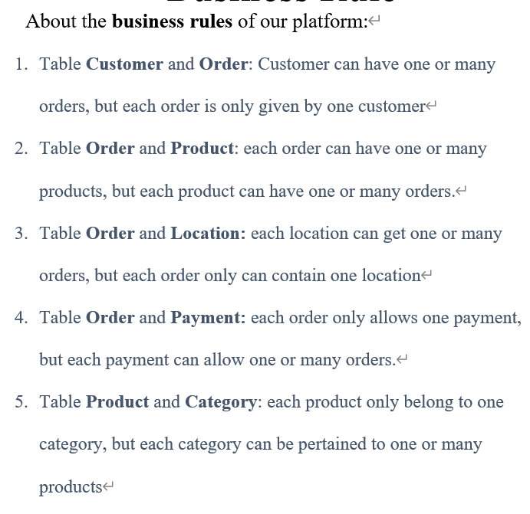
Business Rule

Slide 6
Logical design
Map conceptual model to logical model components
• Validate logical model using normalization
• Validate logical model integrity constraints
• Validate logical model against user requirements

Slide 7
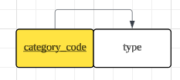
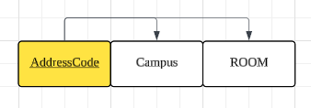
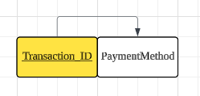
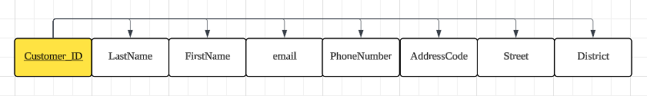
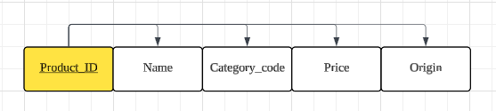
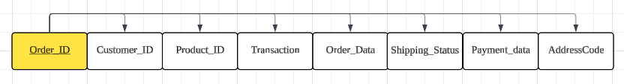
normalization
Logical design

Slide 8
relationship
Customer table and Order table is 1: M.
Location table and Order table is 1: M.
Payment table and Order table is 1: M.
PRODEUCT_ORDER and Order table is 1: M.
Product table and PRODEUCT_ORDER table is 1: M.
Category table and Product table is 1: M.
Logical design

Slide 9
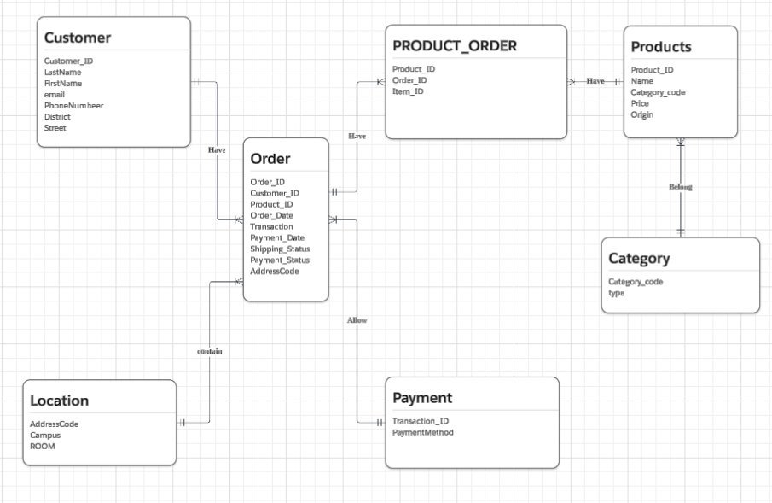
Conceptual model (ERD)

Slide 10
Queries design
integrity constraints （check data）
Data type, Rule
Focuses on crafting SQL
user requirements (for user)
Check the input data
UI, interface
Logical design

Slide 11
integrity constraints
Prevents logical errors in queries
If the rule is “NOT NULL”, Can not inserting “NULL”
Ensures data validity
PRIMARY KAY can not be duplicate
If the Data type is “Date/Time”, The data only can be Date.

Slide 12
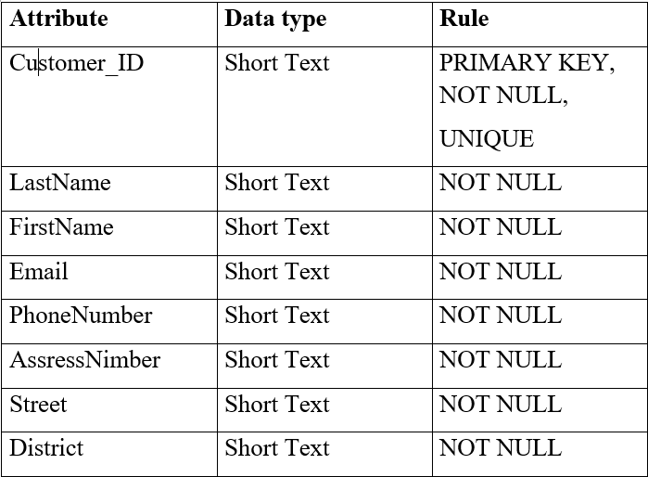
Example: Table Customer
Data type: Short Text Rule: Customer_ID
(PRIMARY KEY, NOT NULL, UNIQUE)

Slide 13
User requirements
User requirements in query design define what data users need to retrieve, analyze, or manipulate from a database.
Key Aspects
Data Needs
User interaction
Output Format

Slide 14
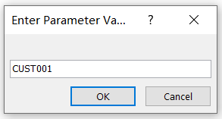
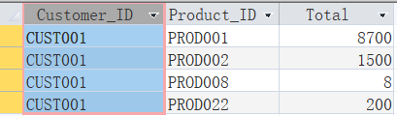
Example: Query(Using Customer_ID to find Total Cost)

Slide 15
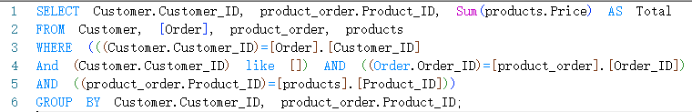

Example: Query(Using Customer_ID to find Total Cost)
Data needs↓
←From which table
←Data Connect
←Data Connect
←Output Format

Slide 16
Example: Query(Using Customer_ID to find Total Cost)
←User interaction
Output Format↓

Slide 17
Demonstration

Slide 18
Conclusion
The database management system allows maintainer queuing, changing and adding data. (For maintaining)
The enterprise can view data only in system.(For business)
This design ensures efficient data management while maintaining security and control.

